Slide 1
ANTIMICROBIALS

Slide 2
Antimicrobials
GENERAL INFORMATION:
A. Terminolgy:
Bacteriostatic:
- Prevents multiplication and growth of bacterial organisms, inhibiting its growth will eventually lead to bacterial death
Bactericidal:
- Kills bacterial organisms

Slide 3
B. Cultures need to be obtained before initiating therapy (e.g.____)
C. Sites of Action
Inhibiting bacterial wall synthesis
Inhibiting Protein synthesis
Interfering bacterial cell membrane permeability
Antimetabolite action
Inhibiting Nucleic acid synthesis

Slide 4
D. Peak and Trough levels
1. Blood levels need to be high enough to be therapeutic but not so high that severe toxicity is caused
2. Peak: Client’s blood is drawn 30 minutes after giving dose
3.Trough: Clients blood is drawn 15-30 minutes before next dose of antibiotic is given

Slide 5
E. Resistance
Ability of bacteria over time to adapt to an antibiotic and produce cells that are no longer affected by the drug
STREPTOGRAMINS –antibiotics to treat resistant strains of bacteria. Used to treat Vancomycin resistant Enterococcus(VRE) and Methicillin resistant S. aureus(MRSA)
-Quinipristin/Dalfoprostin(Synercid)
- Linezolid(Zyvox)

Slide 6
F. Spectrum
Range of bacteria against which an antibiotic is effective
G. Superinfection
Infection occuring when client is receiving antibiotics
Develops when normal bacterial flora are changed by the use of an antibiotic. Allows growth of bacteria that are resistant to the antibiotic being used
Clients more susceptible when placed on broad spectrum antibiotics

Slide 7
Antimicrobials
PENICILLINS
PENICILLIN G POTASSIUM (PENTIDS)
*Inhibits cell wall synthesis of microorganisms;
bactericidal
*Systemic infections of gram-positive cocci;
(Streptococcus, Enterococcus, Staphylococcus species)
syphilis, prophylaxis for rheumatic fever &
bacterial endocarditis
*A/R: hypersensitivity; GI upset, nephritis,
anemia, leukopenia & thrombocytopenia

Slide 8
Antibiotics: Penicillins
a. Natural penicillins
penicillin G, penicillin V potassium
b. Penicillinase-resistant penicillins
cloxacillin, dicloxacillin, methicillin, nafcillin, oxacillin
* Decreased absorption and decreased serum levels if taken with food.

Slide 9
c. Aminopenicillins
amoxicillin, ampicillin, bacampicillin
* Use cautiously with renal disorders, lactation.
d. Extended-spectrum penicillins
piperacillin, ticarcillin, carbenicillin, mezlocillin
e. Penicillin/Beta lactamase inhibitor

Slide 10
Antibiotics: Penicillins
Chemicals have been developed to inhibit these enzymes:
clavulanic acid
tazobactam
sulbactam
These chemicals bind with beta-lactamase and prevent the enzyme from breaking down the penicillin

Slide 11
Antibiotics: Penicillins
Penicillin-beta-lactamase inhibitor combination drugs:
ampicillin + sulbactam = Unasyn
amoxicillin + clavulanic acid = Augmentin
ticarcillin + clavulanic acid = Timentin
piperacillin + tazobactam = Zosyn

Slide 12
Antibiotics: Nursing Implications
Penicillins
Monitor for allergic reactions. Have emergency equipment available
Empty stomach with full glass of water
Monitor CBC, BUN, creatinine
Probenecid(Benemid) may be given to increase blood levels of penicillin

Slide 13
Cephalosporins
*Inhibits bacterial cell wall synthesis; bactericidal
(same action for all generations)
*Against gram-positive cocci
*A/R: hypersensitivity; nephrotoxicity & hepato-
toxicity

Slide 14
Cephalosporins: First Generation
cefazolin cephalexin
(Ancef and Kefzol) (Keflex and Keftab)
IV and PO PO
used for surgical prophylaxis, URIs, otitis media

Slide 15
Cephalosporins: Second Generation
Cefoxitin cefuroxime
(Mefoxin) (Kefurox and Ceftin)
IV and IM PO
Used prophylactically for Surgical prophylaxis abdominal or colorectal surgeries Does not kill Also kills anaerobes anaerobes

Slide 16
Cephalosporins: Third Generation
cefixime (Suprax)
Only oral third-generation agent
Best of available oral cephalosporins against gram-negative
Tablet and suspension
ceftriaxone (Rocephin)
IV and IM, long half-life, once-a-day dosing
Easily passes meninges and diffused into CSF to treat CNS infections

Slide 17
Cephalosporins: Third Generation
ceftazidime (Ceptaz, Fortaz, Tazidime, Tazicef)
IV and IM
Excellent gram-negative coverage
Used for difficult-to-treat organisms such as Pseudomonas spp.
Eliminated renally instead of biliary route
Excellent spectrum of coverage

Slide 18
Cephalosporins: Fourth Generation
cefepime (Maxipime)
Newest cephalosporin agents.
Broader spectrum of antibacterial activity than third generation, especially against gram-positive bacteria.

Slide 19
Assess history of penicillin allergy
Increased risk of renal toxicity if given with other nephrotoxic drugs
Monitor renal, liver, and I and O
Probenecid therapy

Slide 20
Aminoglycosides
General Information on all agents
GENTAMICIN (GARAMYCIN) “Mycins”
*Suppresses protein synthesis in bacterial cell;
bactericidal
*Against gram-negative bacterial infections;
eye infections
*A/R: ototoxicity; nephrotoxicity & neuromuscular
blockage, photosensitivity

Slide 21
Antibiotics: Aminoglycosides
gentamicin (Garamycin)
kanamycin
neomycin
streptomycin
tobramycin
amikacin (Amikin)

Slide 22
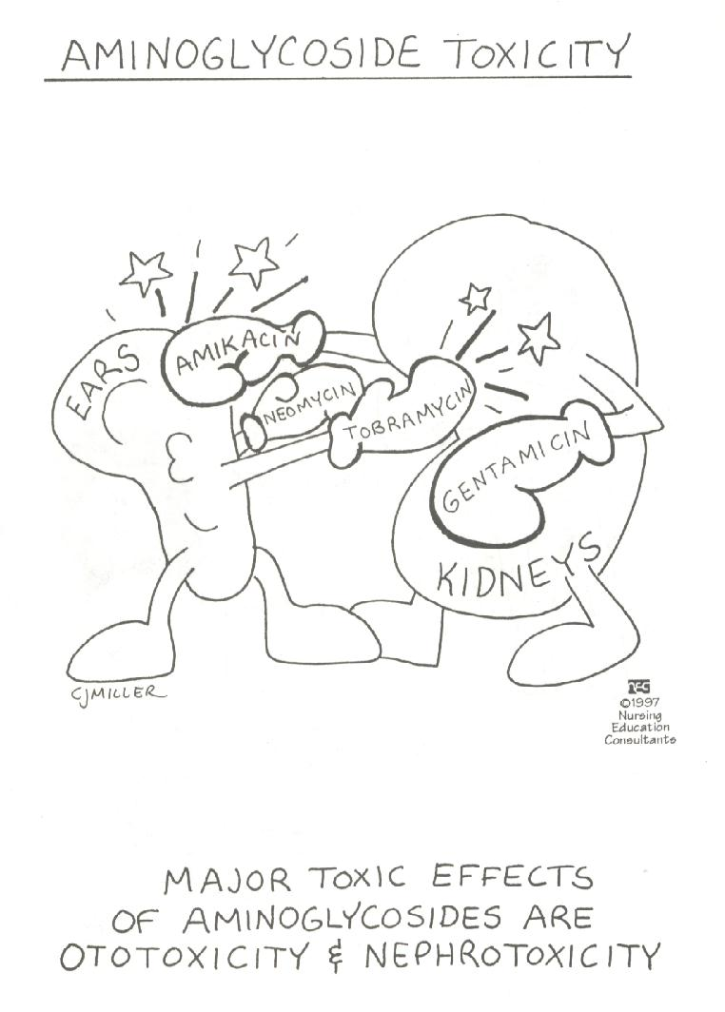

Slide 23
Aminoglycosides
Three most common (systemic): gentamicin, tobramycin, amikacin
Cause serious toxicities:
Nephrotoxicity (renal failure)
Ototoxicity (auditory impairment and vestibular [eighth cranial nerve])

Slide 24
Antibiotics: Nursing Implications
Aminoglycosides
Monitor peak and trough blood levels of these agents to prevent nephrotoxicity and ototoxicity.
Symptoms of ototoxicity include dizziness, tinnitus, and hearing loss.
Symptoms of nephrotoxicity include urinary casts, proteinuria, and increased BUN and serum creatinine levels.

Slide 25
Vancomycin
VANCOMYCIN HCl (VANCOCIN)
*Interferes with cell membrane activities; bacteriostatic & bactericidal
*DOC for MRSA
*A/R:
T hrombophlebitis,
A minoglycoside effects
R ed-neck syndrome (flushing & hypotension from rapid IV infusion)

Slide 26
Macrolide
ERYTHROMYCINS – ERYTHROMYCIN BASE (E-MYCIN)
*Inhibits protein synthesis in bacterial cell; bacteriostatic
*Used in persons with allergy to penicillins; Legionnaires disease, streptococcal & staphylococcal infections
*A/R: GI irritation, allergic reactions, hepatitis

Slide 27
Macrolides: Side Effects
erythromycin
azithromycin (Zithromax)
clarithromycin (Biaxin)
dirithromycin
Newer agents, azithromycin and clarithromycin: fewer side effects, longer duration of action, better efficacy, better tissue penetration

Slide 28
Antibiotics: Nursing Implications
Macrolides
Do not crush enteric coated
The absorption of oral erythromycin is enhanced when taken on an empty stomach, but because of the high incidence of GI upset, many agents are taken after a meal or snack.
Monitor liver function tests
Do not give with acids (e.g. orange juice)
Report superinfections

Slide 29
Tetracyclines
TETRACYCLINE HCl (ACHROMYCIN V)
*Inhibits bacterial cell wall synthesis; bacteriostatic &
bactericidal; reduces fatty acids from triglycerides
*Used for acne vulgaris, gonorrhea & spirochetes
*A/R: photosensitivity, hepatotoxicity; staining to teeth and new bones..avoid giving to pregnant & nursing women, children under 8 as drug binds to Ca in teeth & new bones causing permanently discolored teeth & retarded bone growth

Slide 30
Antibiotics: Tetracyclines
tetracycline
doxycycline (Doryx, Doxy-Caps, Vibramycin)
demeclocycline (Declomycin)
oxytetracycline
minocycline

Slide 31
Antibiotics: Nursing Implications
Tetracyclines
Milk products, iron preparations, antacids, and other dairy products should be avoided because of the drug-binding can occurs.
(Bind to Ca²⁺ and Mg²⁺ and Al³⁺ ions to form insoluble complexes)
All medications should be taken with 6 to 8 ounces of fluid, preferably water.
Due to photosensitivity, avoid sunlight and tanning beds.
Avoid during pregnancy and children below 8 yrs old

Slide 32
Quinolones
*referred to as 4 quinolone or fluroqinolone
*Bactericidal
*Effective against gram-negative organisms and some gram-positive organisms
*Alter DNA of bacteria, causing death
*Do not affect human DNA
Notes:
CIPROFLOXACIN (CIPRO)
*Inhibits DNA-gyrase (an enzyme needed for replication of
bacterial DNA); bactericidal
*Used against gram-negative systemic/urinary infections;
Pseudomonas infection
*A/R: nephrotoxic & hapatotoxic; anemia & leukopenia;
crystalluria
CIPROFLOXACIN (CIPROBAY)
=alters bacterial DNA by interfering w/ DNA gyrase & posibly by direct interaction w/ DNA itself
= inhibit bacterial RNA synthesis
DRUG INTERACTION
= antacids..1H before or 2H after ingesting antacids
= probenecid
= theophylline
Child therapy is not recommended in children d/t potential for causing permanent damage to cartilageDRUG INTERACTION
= antacids
= probenecid
= theophylline

Slide 33
Antibiotics: Quinolones
ciprofloxacin (Cipro)
enoxacin (Penetrex)
lomefloxacin (Maxaquin)
norfloxacin (Noroxin)
ofloxacin (Floxin)

Slide 34
Quinolones
S/E =N/V, diarrhea, discomfort, dizziness, lightheadedness
S/E TO REPORT
= rash
= neurologic effects: H/A, mental depression
DRUG INTERACTION
= antacids
= probenecid
= theophylline

Slide 35
Antibiotics: Nursing Implications
Quinolones
Administered with large glass of water to prevent crystalluria
Should be taken with at least 3 L of fluid per day, unless otherwise specified
Do not give with antacids

Slide 36
Chloramphenicol
CHLORAMPENICOL (CHLOROMYCETIN)
*Inhibits CHON synthesis; bacteriostatic & bactericidal
*Used against Haemophilus influenzae meningitis, salmonella typhi- used only in severe infections where other antibiotics can’t be used because A/R are aplastic anemia & gray baby syndrome
(seen in premature infant & children below 2 years…experiences vomiting, abdominal distention, irregular respirations & circulatory collapse)

Slide 37
Chloramphenicol: Nursing Implications
Inform physician immediately of fever, fatigue, sore throat or bruising
Take drug on an empty stomach unless GI upset

Slide 38
Sulfonamides: Mechanism of Action
Bacteriostatic action
Prevent synthesis of folic acid required for synthesis of purines and nucleic acid
Does not affect human cells or certain bacteria—they can use preformed folic acid

Slide 39
Antibiotics: Sulfonamides
One of the first groups of antibiotics
sulfadiazine
sulfamethizole
sulfamethoxazole
sulfisoxazole

Slide 40
Sulfonamides: Side Effects
Body System Effect
Blood Hemolytic and aplastic anemia, thrombocytopenia
Integumentary Photosensitivity, exfoliative dermatitis, Stevens-Johnson syndrome, epidermal necrolysis
SJS: acute onset fever, bullae on skin and ulcers on mucous membranes)
Hemolytic: fever 7-10 days after starting therapy

Slide 41
Sulfonamides: Side Effects
Body System Effect
GI Nausea, vomiting, diarrhea, pancreatitis
Other Convulsions, crystalluria, toxic nephrosis, headache, peripheral neuritis, urticaria

Slide 42
Antibiotics: Nursing Implications
Sulfonamides
Empty stomach with full glass of water
Should be taken with at least 2400 mL of fluid per day, unless contraindicated, to prevent crystalluria
Due to photosensitivity, avoid sunlight and tanning beds.
These agents reduce the effectiveness of oral contraceptives.
Diabetics need to be aware of increased chance of hypoglycemic reactions with use of sulfonamides

Slide 43
Integumentary Drugs
ACNE PRODUCTS
Isotretinoin (Accutane)
*metabolite of vitamin A
*treatment for severe cystic acne
*C/I: sun exposure, ROH & pregnancy

Slide 44
BURNS PRODUCT
Mafenide (Sulfamylon)
*bacteriostatic against gram-negative & gram-positive org.
*apply 1/6 inch film directly to burn
*A/R diffuses via devascularized areas; may precipitate metabolic
acidosis manifested by hyperventilation; bone marrow depression
& hemolytic anemia

Slide 45
Integumentary Drugs
Burns Products
nitrofurazone (Furacin)
*bactericidal
*apply 1/16 inch film directly to burn
*A/R: contact dermatitis & rash
silver sulfadiazine (Silvadene, Flint SSD)
*bactericidal against gm-positive, gm-negative org. & yeast
*apply 1/16 inch film to burn
*A/R: leukopenia

Slide 46
silver nitrate
*antiseptic against gm-negative org.
*apply to dressing & not to wound or broken skin
*A/R: stains anything it comes into contact with but
discoloration is not permanent

Slide 47
Antitubercular Drugs
General Considerations
ISONIAZID (INH)
*Initial TTT against PTB; prophylaxis for high-risk groups
*A/R: peripheral neuritis)…give vitamin B6 (pyridoxine);
hepatitis…check liver enzymes frequently; hyperexcitability
*Taken on empty stomach, avoid alcohol & interferes with
Phenytoin (Dilantin) requiring lowering of INH dose
ETHAMBUTOL (MYAMBUTOL)
*A/R: optic neuritis & loss of red-green color discrimination but
it’s reversible

Slide 48
Antitubercular Drugs
RIFAMPICIN
*A/R: hepatitis, flu-like syndrome, may turn body fluids (urine,
tears, saliva etc. ) orange
*Interacts with anticoagulants, oral contraceptives, oral
hypoglycemics, methadone & corticosteroids
STREPTOMYCIN
*A/R: cranial nerve 8 damage (roaring, ringing & feeling of
fullness in the ear); vestibular damage (dizziness & vertigo)
PYRAZINAMIDE
*A/R: increased uric acid causing gout or hepatitis

Slide 49
Antifungal
Amphoterizin B (fun gizone)
* shld be mixed only w/ water & slowly infuse
* BUN, liver enzymes, u/a shld be checked
Butoconazole nitrate (femstat)
Ketonazole (nizoral)
Miconazole (monistat)
Nystatin (mycostatin)

Slide 50
Antivirals
Acyclovir (Zovirax), Valacyclovir (Valtrex)
Treatment for herpes simplex I, herpes zoster (shingles), genital herpes simplex II, cytomegalovirus (CMV)
amantadine HCl (Symmetrel), for influenza A
cidofovir (Vistide), for CMV retinitis
foscarnet (Foscavir), for herpes viruses and CMV retinitis
rimantadine HCl (Flumadine), for influenza A
vidarabine monohydrate (Vira-A), for herpes viruses

Slide 51
Antivirals
Side Effects:
dizziness, HA, n/v, diarrhea, nephrotoxicity, peripheral neuropathy, pancreatitis
Implications:
Maintain adequate fluid intake
Wear gloves when applying topical preparations

Slide 52
Antimalarial Drugs
Malaria
Etiology: protozoan parasites Plasmodium species
Treatment regimen: combinations of antimalarials for drug-resistant malaria
Prophylactic measures
Quinine- 1st drug used to treat malaria
Hydroxychloroquine SO4 (Plaquenil) - commonly prescribed
Many side effects for the various agents
Primarily gastrointestinal: nausea, vomiting, diarrhea, anorexia, and abdominal pain

Slide 53
Antimalarial Agents: Nursing Implications
Assess for presence of malarial symptoms.
When used for prophylaxis, these agents should be started 2 weeks before potential exposure to malaria, and for 8 weeks after leaving the area.
Take same day every week when entering high risk area
Medications are taken weekly, with 8 ounces of water.

Slide 54
Antihelmintics
Drugs used to treat parasitic worm infections: helmintic infections
Unlike protozoa, helminths are large and have complex cellular structures
Drug treatment is very specific

Slide 55
Anti-helmintics
Mebendazole (Vermox) (Antiox)
Metronidazole (Flagyl)
Quinine sulfate

Slide 56
Antihelminths
Emphasize basic hygiene such as regular handwashing and no sharing of personal items with others
If patient is receiving mebendazole, assess for signs of candidal overgrowth
Advise the patient that all sexual partners should be treated with metronidazole
Administer with food to prevent GI irritation

Slide 57
Antineoplastic Agents

Slide 58
NEOPLASMS
New or cancerous growth; occurs when abnormal cells have the opportunity to mulitiply and grow
Anaplasia: loss of organization and structure

Slide 59
Autonomy: loss of the normal controls and reactions that inhibit growth and spreading
Metastasis: ability to enter the circulatory or lymphatic system and travel to other areas of the body that are conducive to growth and survival

Slide 60
Cell Cycle
G Phase
G₀ – resting phase
G₁ – manufactures enzymes
G₂ – specialized DNA & RNA are synthesized for mitosis
S Phase (Synthesis Stage)
DNA replication occurs in preparation for mitosis
M Phase (Mitosis Stage)
Final stage during which cells divide

Slide 61
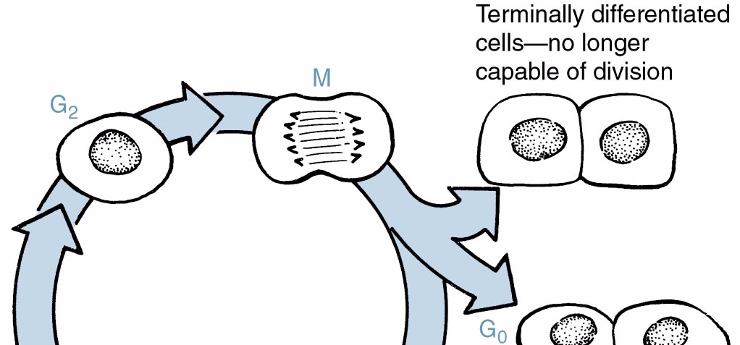

Slide 62
Goals
Long term survival – cure
Control of tumor growth – palliative
Prophylactic
Factors that play major role in in Ca cell response
Growth Fraction
Doubling Time

Slide 63
Contraindication
Infection
Recent surgery
Impaired renal / hepatic function
Recent radiotherapy
Pregnancy
Bone marrow depression

Slide 64
Nursing Implications: Antineoplastics
Handle Antineoplastic agents carefully-mutagenic and possibly carcinogenic
Nurses should wear gloves
Monitor IV site for extravasation
Treat used equipments as hazardous waste

Slide 65
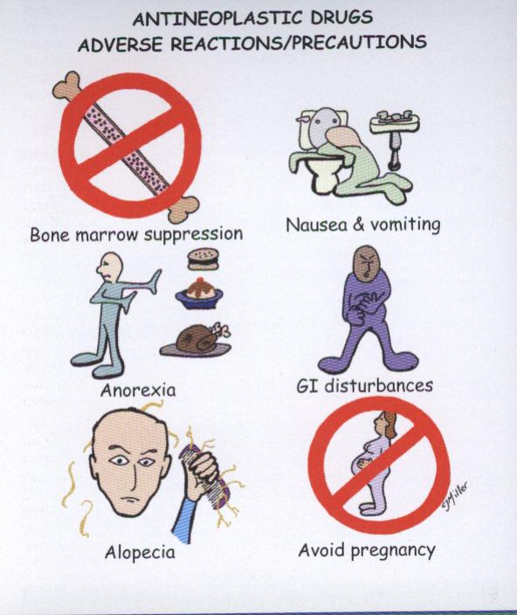

Slide 66
Types of Cancer Cell Drugs
Cell Cycle Non Specific
Alkylating drugs
Antitumor antibiotics
Hormones
Cell Cycle Specific
Antimetabolites
Vinca Alkaloids
Antitumor antibiotics (Doxorubicin)

Slide 67
Classification of Antineoplastic Agents
Alkylating Agents
Produces cytotoxic effects by damaging DNA and interfering with cell replication
Cyclophosphamide (Cytoxan)
Hemorrhagic Cystitis (Mesna - Mesnex)
Prolonged tx – interstitial pulmonary fibrosis
- cardiomyopathy

Slide 68
Mechlorethamine (Mustargen)
Combined with Vincristine, Procarbazine and Prednisone
Administered IV – vesicant (Isotonic Na Thiosulfate) Busulfan (Myeleran)
Hyperuricemia – (Allopurinol)
Cisplatin (Platinol AQ)
Renal toxicity – (Amifostine - Ethyol)
Ifosfamide (Ifex)
Hemorrhagic cystitis (Mesna - Mesnex)

Slide 69
* Withhold medication if the platelet count is lower than 75,000/mm³ or the neutrophil count is lower than 2,000/mm³ and notify the physician (this may vary depending on alkylating agent and agency policy).
* When administering cisplatin assess the client for dizziness, tinnitus, hearing loss, incoordination, and numbness or tingling of extremities.

Slide 70
* Instruct the client that cyclophosphamide, when prescribed orally, is administered without food.
* Instruct the client to follow a diet low in purines to alkalinize the urine and lower uric acid blood levels.

Slide 71
Antimetabolites
Inhibit DNA production in cells that depend on certain natural metabolites to produce their DNA
Acts during the S phase
Methotrexate (Mexate)
Prolonged low dose – hepatic dysfunction

Slide 72
High doses – renal failure
Avoid protein bound drugs
Leucovorin (Wellcovorin) folic acid analogue
Mercaptopurine (6MP, Purinethol)
Jaundice – biliary stasis and liver necrosis
Hyperuricemia and hyperuricosuria

Slide 73
* Cytarabine (DepoCyt, Tarabine PFS) may cause alopecia, stomatitis, hyperurecemia, and hepatotoxicity.
* Fluorouracil (Adrucil) my cause alopecia, stomatitis, diarrhea, phototoxicity reactions, and cerebellar dysfunction.
* Methotrexate may cause photosensitivity, hepatotoxicity, and hematological, gastrointestinal, and skin toxicity.

Slide 74
Hold medication if the neutrophil count is lower than 2000 cells/mm³ or the platelet count is lower than 75,000/mm³ and notify the physician (this may vary depending on alkylating agent and agency policy.)
When administering fluorouracil, assess for signs of cerebellar dysfunction, such as dizziness, weakness, and ataxia, and assess for stomatitis and diarrhea, which may necessitate medication discontinuation.

Slide 75
When administering methotrexate in large doses, prepare to administer leucovorin (folinic acid or citrovorum factor) as prescribed to prevent toxicity (known as leucovorin rescue).
When administering fluorouracil or methotrexate, instruct the client to use sunscreen and wear protective clothing to prevent photosensitivity reactions.

Slide 76
Antibiotics Antineoplastics
Disrupts DNA synthesis → binds with DNA → fragmentation
Considered CCNS except Doxorubicin
Doxorubicin(Adriamycin), Bleomycin
Disrupt S phase
Reddish urine (1-2 days)
Cardiac toxicity (Dexrazoxane - Zinecard)

Slide 77
* Daunorubucin (DaunoXome) may cause congestive heart failure nd dysrhythmias.
* Doxorubucin (Adriamycin, Doxil) and idarubucin may cause cardiotoxicity, cardiomyopathy, and electrocardiographic changes (Dexrazoxane [Zinecard] may be administered with doxorubicin to reduce cardiomyopathy).
* Pulmonary toxicity can occur with bleomycin (Blenoxane)

Slide 78
Assess for myocardial toxicity, dyspnea, dysrhythmias, hypotension, and weight gain when administering doxorubicin (Adriamycin, Doxil) or idarubicin.
Monitor pulmonary status when administering bleomycin (Blenoxane)

Slide 79
4. Plant Alkaloid / Mitotic Inhibitors
Kills cells as the process of mitosis begins
Acts on the M phase of cell cycle
Vinblastine
Leukopenia – 4 -10 days
Vincristine
Neurotoxic
* Monitor for neurotoxicity with vincristine sulfate manifested as numbness and tingling in the fingers and toes.

Slide 80
Hormones and Hormone Modulators
Blocks receptor sites → prevent CA growth → cell death
Tamoxifen (Novaldex)
antiestrogen – compete with estrogen for receptor sites (tx for breast CA)
Toremifene (Fareston)
Binds with estrogen receptor
Corticosteroids
Inhibits cellular glucose transport → decrease amt of energy needed for mitosis and CHON synthesis

Slide 81
Protein Tyrosine Kinase Inhibitor
Inhibits tyrosine kinase, inhibiting cell proliferation and blocking tumor growth
With specific effect on tumor cells
Imatinib (Gleevec)
Gefitinib (Iressa)

Slide 82
Miscellaneous Agents
Asparaginase (Elspar), Pegasparaginase (Oncaspar)
CCS, G₁ phase of cell cycle
Hydrolyzes amino acid aspargine needed by CA cells for protein synthesis
Dacarbazine (DTIC 0 Dome), Procarbazine (Matulane)
Inhibits DNA and RNA synthesis
Paclitaxel (Taxol)
Inhibits normal dynamic reorganization of microtubules
Interferes with late G₂ phase

Slide 83
Nursing Responsibilities
Mucous membrane
Routine inspection of the oral cavity
Routine mouth care (every 2-4 hrs)
Rinse mouth thoroughly after meals
Assess or note for evidence of GI upset

Slide 84
2. Nausea and vomiting
Provide foods that would decrease nausea and vomiting
If persistent give antiemetic agents
Ordansetron (Zofran), Granisetron (Kytril)
Dronabinol (Marinol), Metoclopramide (Reglan)

Slide 85
Alopecia
Counsel the client
Encourage use of wigs or any head ornaments
Bone marrow depression
Observe for signs of bleeding
Check for sign of infection
Protective isolation
Allupurinol(Zyloprim)

Slide 86
Kidney function
Monitor intake and output
Force oral fluids and frequent voiding(prevent accumulation of metabolites)

Slide 87
Other considerations
Pregnancy should be avoided
Avoid direct contact with the antiCA agents
Extravasation(escape into the tissues)

Slide 88
Stop infusion, aspirate as much of the drug as possible
Administer lidocaine into the area
Apply ice pack for the 1st 24-36 hrs, then warm moist compress
Elevate the IV site above the level of the heart

